Slide 1

Wagner
Verdi

Slide 2


Slide 3


Verdi
&
Puccini

Slide 4
Wolfgang Amadeus Mozart

Slide 6


Slide 7


Slide 8


Slide 9
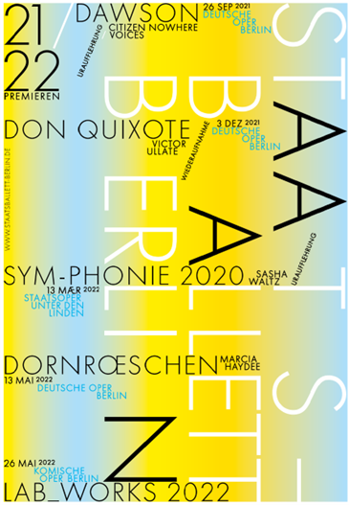

Slide 10

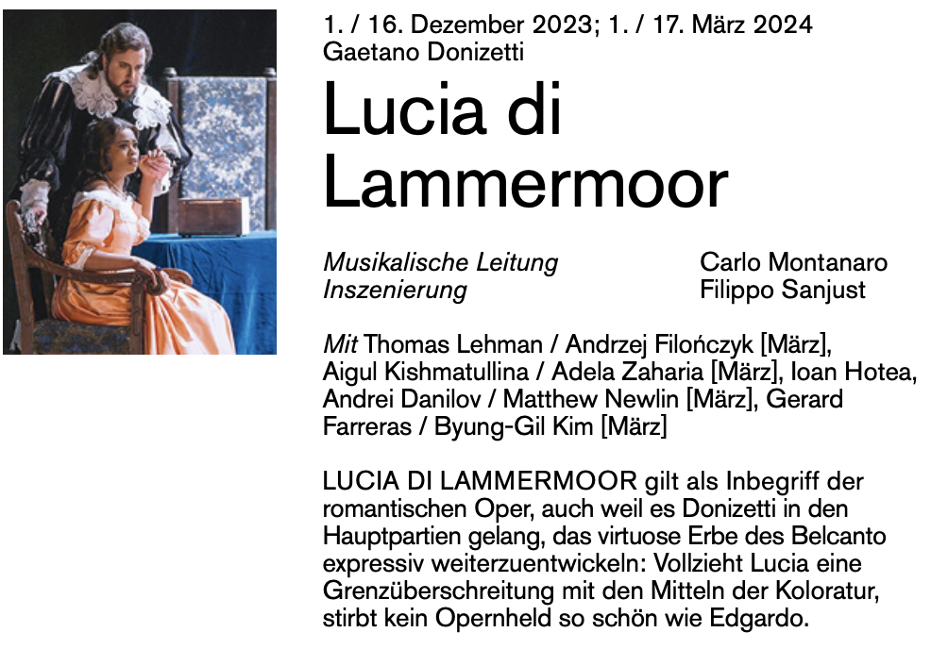
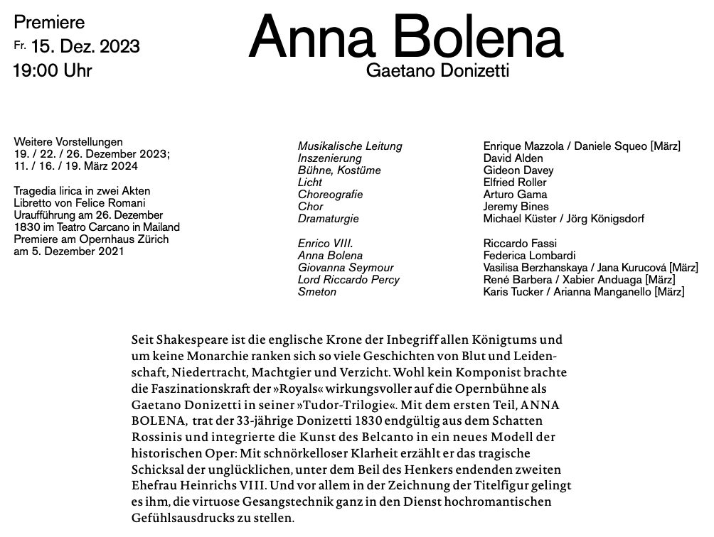








Slide 11







